Slide 1

#LifeKoKaroLift
PG Diploma in Data Science-Data Engineering

Slide 2



Course : PG Diploma in Data Science-Data Engineering
Session On : Hadoop and MapReduce Programming
Instructor: Siddhesh Pisal

Slide 3
Today’s Agenda
1
Introduction to Hadoop
2
HDFS (Architecture, Load Balancing, Rack Awareness)
3
MapReduce Framework
4
YARN
5
Map Reduce Limitations
6
Example Walk Through

Slide 4
Introduction to Hadoop
Hadoop can be thought of as a set of open source programs and procedures which anyone can use as the "backbone" of their big data operations
Problems with Traditional Approach
1. Storing the colossal amount of data.
2. Storing heterogeneous data and process huge data sets.
3. Accessing and processing speed.
It was quickly becoming useful for anybody to be able to store and analyze datasets far larger than can practically be stored and accessed on one physical storage device (such as a hard disk).
This is partly because as physical storage devices become bigger it takes longer for the component that reads the data from the disk (which in a hard disk, would be the "head") to move to a specified segment. Instead, many smaller devices working in parallel are more efficient than one large one.

Slide 5
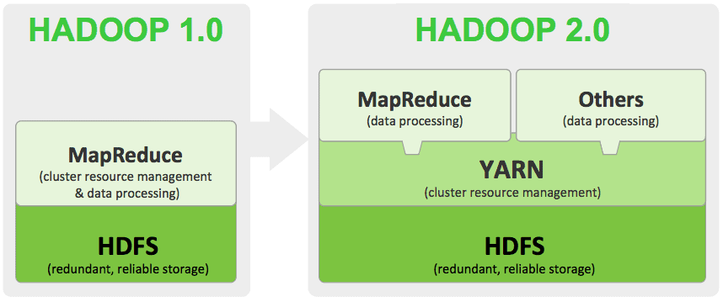
Introduction to Hadoop
Allows distributed processing of large datasets across clusters of computers
Provides distributed storage and computation across clusters of computers
Designed to scale up from single server to thousands of machines, each offering local computation and storage

Slide 6
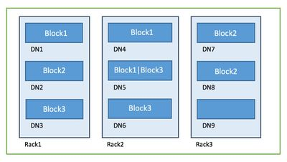
HDFS Architecture
Distributed Storage: Divides the data into small pieces and stores it on different Data Nodes in the cluster
Blocks: Block is the smallest unit of data in a filesystem. HDFS default block size is 128 MB
Replication: Hadoop HDFS creates duplicate copies of each block. All blocks are replicated and stored on different Data Nodes across the cluster. Default replication factor is 3
Rack Awareness: A rack consists of multiple data nodes on a single network switch. Name Node places replicas of a block on multiple racks. Name Node tries to place at least one replica of a block in a different rack
Even if a complete rack goes down, the system will still be highly available
improve data reliability, availability, and network bandwidth utilization

Slide 7
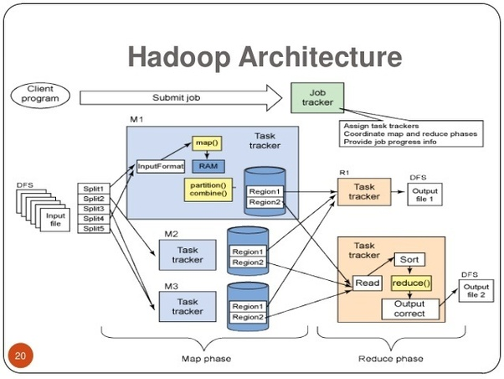
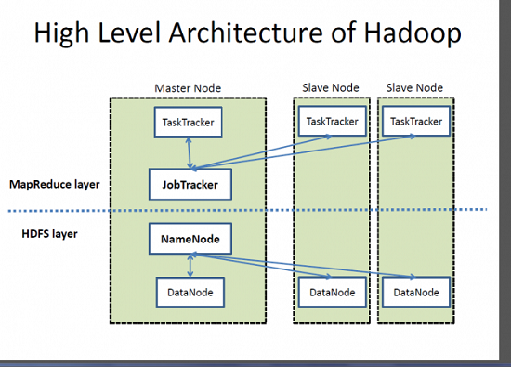
HDFS Architecture

Slide 8
HDFS Architecture
Advantages
Scalable
Cost Effective
Flexible
Fast
Fault Tolerant
Disadvantages
Security Complexity (No encryption at storage and network levels)
Vulnerabilities
Not fit for small data
Stability issues

Slide 9
HDFS (Q&A)

Slide 10




Poll 1
Hadoop uses commodity servers only. We can not use high end machines to install Hadoop.
No
Yes
None of the above
Practice in teams of 4 students
Industry expert mentoring to learn better
Get personalised feedback for improvements
22/06/20
11

Slide 11
Poll 1(Answer)
Hadoop uses commodity servers only. We can not use high end machines to install Hadoop.
No
Yes
None of the above
Practice in teams of 4 students
Industry expert mentoring to learn better
Get personalised feedback for improvements
22/06/20
11

Slide 12
Poll 2
Block size is always fixed, and it is 128 MB.
No
Yes
If it is not defined than we can change otherwise we can not change.
3. None of the above
Practice in teams of 4 students
Industry expert mentoring to learn better
Get personalised feedback for improvements
22/06/20
11

Slide 13
Poll 2(Answer)
Block size is always fixed, and it is 128 MB.
No
Yes
If it is not defined than we can change otherwise we can not change.
3. None of the above
Practice in teams of 4 students
Industry expert mentoring to learn better
Get personalised feedback for improvements
23/06/20
11

Slide 14
MapReduce Framework
MapReduce is a Distributed Data Processing Algorithm introduced by Google
It is mainly inspired by Functional Programming model
MapReduce algorithm is useful to process huge amount of data in parallel, reliable and efficient way in cluster environments
It divides input task into smaller and manageable sub-tasks to execute them in-parallel
With MapReduce, rather than sending data to where the application or logic resides, the logic is executed on the server where the data already resides, to expedite processing.
Input
Output
Sort and Shuffle
Map
Reduce

Slide 15
MapReduce Framework
Workflow of MapReduce consists of five steps:
Splitting: The splitting parameter can be any character which is specified
Mapping: The mapping takes a set of data and converts it into tuples (Key-Value pair)
Shuffle/Sort: The process is to combine the same tuples from different clusters to provide an input to Reduce
Reduce: The reduce will group by phase.
Combining: The last phase where the phases will be combined to provide the output
Phase | Input | Output
Mapper | (K, V) | (K, V)
Shuffle & Sort | (K ,V) | (K, list(V))
Reducer | (K,list(V)) | (K, V)

Slide 16
MapReduce Framework
At the crux of MapReduce are two functions: Map and Reduce. They are sequenced one after the other.
The Map function takes input from the disk as <key,value> pairs, processes them, and produces another set of intermediate <key,value> pairs as output.
The Reduce function also takes inputs as <key,value> pairs, and produces <key,value> pairs as output

Slide 17
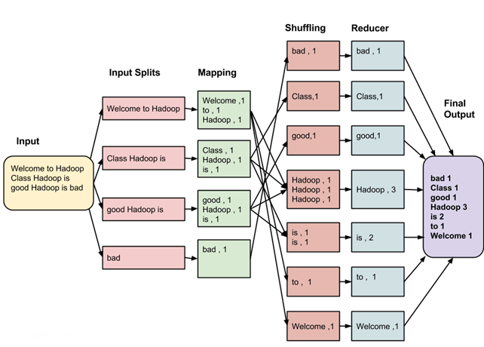
EXAMPLE
Input Data

Slide 18
Map Reduce (Q&A)

Slide 19
Map Reduce Limitations
Suitable only for batch processing (interactive jobs are impossible)
Applications that involve pre-processing on the dataset brings down the advantages of MapReduce
Implementing iterative map reduce jobs is expensive due to the huge space consumption by each job
Due to the fixed cost incurred by each MapReduce job submitted, application that requires low latency time or random access to a large set of data is infeasible
Tasks that have a dependency on each other cannot be parallelized, which is not possible through MapReduce
Alternatives:
Pig
Hive
Spark

Slide 20
Poll 3
Sequence of phases
Input Split ->Map->Combiner->Partitioner->Reducer
Input Split ->Map
3. Input Split ->Map-> Partitioner ->Combiner>Reducer
4. Input Split ->Reducer -> Combiner ->Reducer ->Map
Practice in teams of 4 students
Industry expert mentoring to learn better
Get personalised feedback for improvements
22/06/20
11

Slide 21
Poll 3(Answer)
Sequence of phases
Input Split ->Map->Combiner->Partitioner->Reducer
Input Split ->Map
3. Input Split ->Map-> Partitioner ->Combiner>Reducer
4. Input Split ->Reducer -> Combiner ->Reducer ->Map
Practice in teams of 4 students
Industry expert mentoring to learn better
Get personalised feedback for improvements
22/06/20
11

Slide 22
Poll 4
What are the advantages of 3x replication in Hadoop?
High Availability
Fault Tolerance
Reliability
All of the above
Practice in teams of 4 students
Industry expert mentoring to learn better
Get personalised feedback for improvements
22/06/20
11

Slide 23
Poll 4(Answer)
What are the advantages of 3x replication in Hadoop?
High Availability
Fault Tolerance
Reliability
All of the above
Practice in teams of 4 students
Industry expert mentoring to learn better
Get personalised feedback for improvements
25/06/20
11

Slide 24
YARN (Yet another resource negotiator)
YARN is a general-purpose application scheduling and resource management framework that was initially aimed at improving MapReduce job management
YARN allows different data processing methods like graph processing, interactive processing, stream processing as well as batch processing to run and process data stored in HDFS. Therefore YARN opens Hadoop to other types of distributed applications beyond MapReduce.
YARN enabled the users to perform operations as per requirement by using a variety of tools like Spark for real-time processing, Hive for SQL, HBase for NoSQL and others

Slide 25
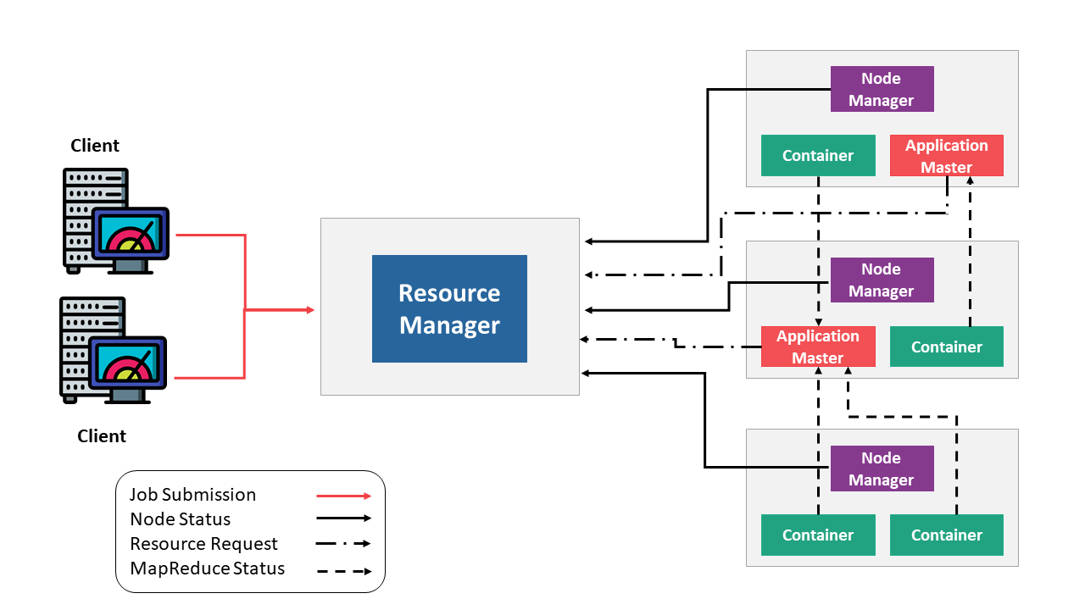
YARN (Yet another resource negotiator)
Main Components:
Resource Manager: Runs on a master daemon and manages the resource allocation in the cluster
Node Manager: They run on the slave daemons and are responsible for the execution of a task on every single Data Node
Application Master: Manages the user job lifecycle and resource needs of individual applications. It works along with the Node Manager and monitors the execution of tasks
Container: Package of resources including RAM, CPU, Network, HDD etc on a single node

Slide 26
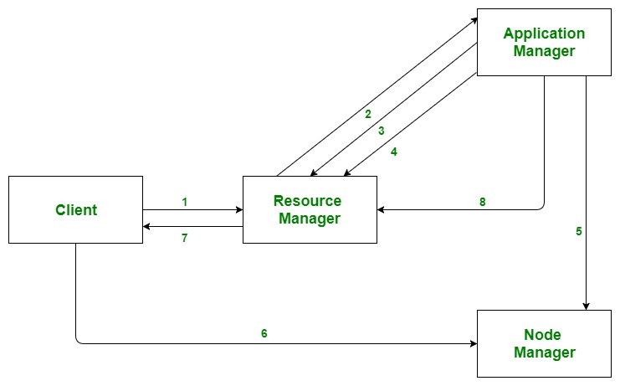
YARN (Yet another resource negotiator)
Workflow:
Client submits an application
The Resource Manager allocates a container to start the Application Manager
The Application Manager registers itself with the Resource Manager
The Application Manager negotiates containers from the Resource Manager
The Application Manager notifies the Node Manager to launch containers
Application code is executed in the container
Client contacts Resource Manager/Application Manager to monitor application’s status
Once the processing is complete, the Application Manager un-registers with the Resource Manager

Slide 27
Poll 5
Can we control Number of Mappers
Yes
No
Not usually but if I can control number of input splits then I can
None of the above.
Practice in teams of 4 students
Industry expert mentoring to learn better
Get personalised feedback for improvements
22/06/20
11

Slide 28
Poll 5(Answer)
Can we control Number of Mappers
Yes
No
Not usually but if I can control number of input splits then I can
None of the above.
Practice in teams of 4 students
Industry expert mentoring to learn better
Get personalised feedback for improvements
22/06/20
11

Slide 29
Poll 6
Rack Awareness improves
Data high availability and reliability
Performance of the cluster
Network bandwidth
All of the above
Practice in teams of 4 students
Industry expert mentoring to learn better
Get personalised feedback for improvements
25/06/20
11

Slide 30
Poll 6(Answer)
Rack Awareness improves
Data high availability and reliability
Performance of the cluster
Network bandwidth
All of the above
Practice in teams of 4 students
Industry expert mentoring to learn better
Get personalised feedback for improvements
25/06/20
11

Slide 31
Q&A
QUESTIONS?

Slide 32
Example Walkthrough
Category wise total sales
Number of artificial stadium rinks

Slide 33
#LifeKoKaroLift
Thank You!

